Slide 1
Angular 14 Course
Arabic Edition – باللغة العربية
Presented By: Ramy Ibrahim

Slide 2
Course Outlines
Introduction
Angular 14

Slide 3
Before we start
Please Practice.
Learning by Practice
Programming studying is different.
Memorization Problem.
Main concepts (Algorithms, Data structure, and Design Patterns).
Love the bugs you found.
Take breaks (Release mode).
2hrs, 15mins(break), 1hr, 15mins(break), 30mins.

Slide 4
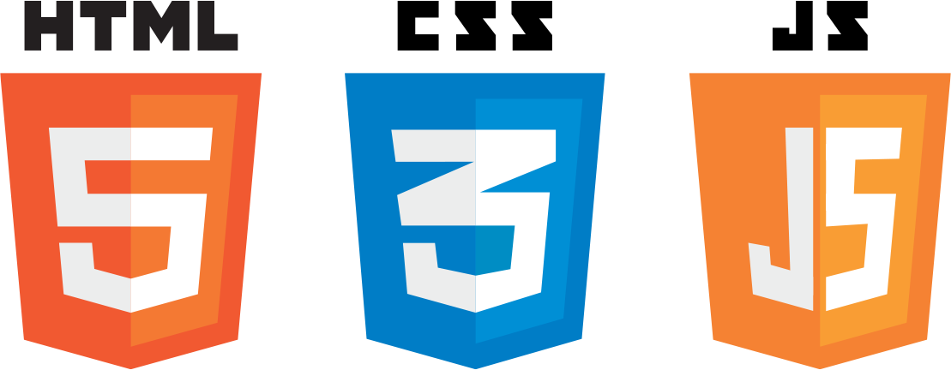
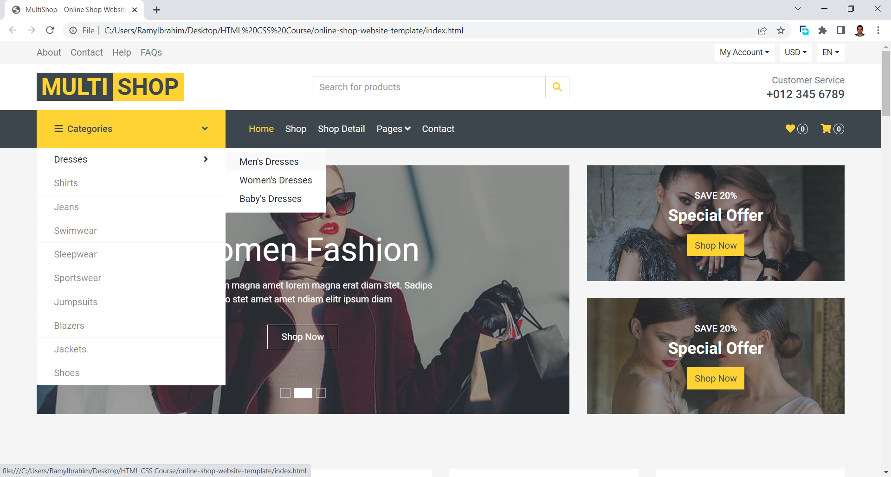

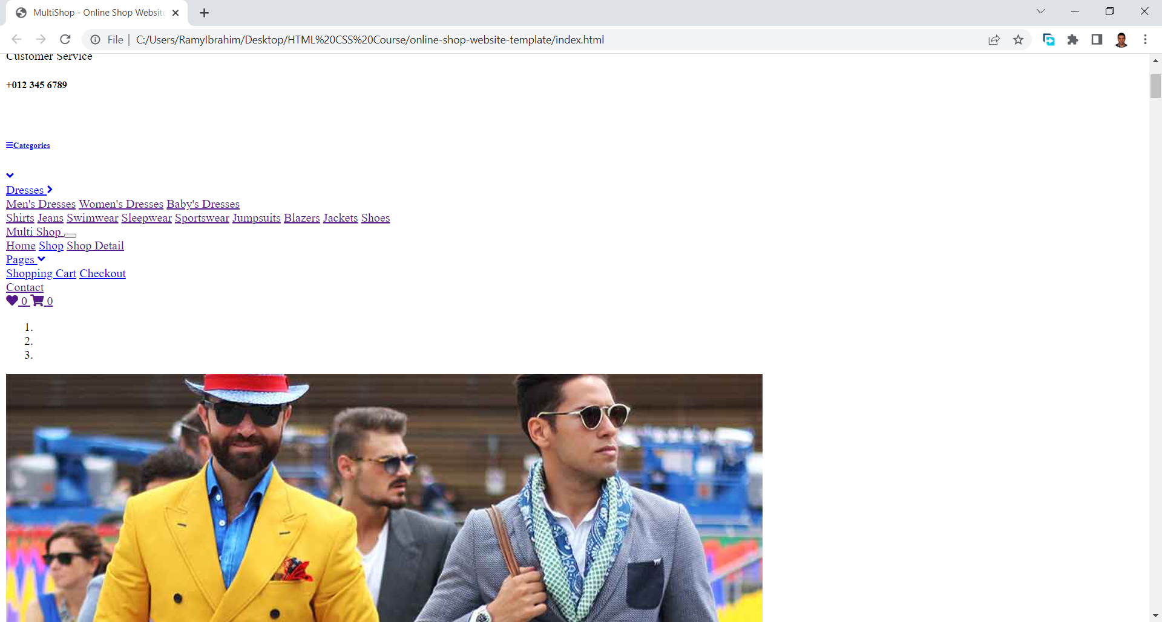
HTML, CSS, and JS
HTML : Content
CSS: Presentation
JS: Actions, Content edit,
Data requests, browser functions
Timers, etc.…

Slide 5
Different approaches to web development
Embedded code
MVC
API
Front, Back
PHP
JSP
ASP
ASP.net
Laravel
Spring
ASP.net MVC
ASP.net web API
Laravel
Spring
Angular
React
VUE
Remove Redundancy
Mobile Development
Logic Separation

Slide 6
Environment setup
Visual studio code
Node (NPM)

Slide 7
E-Commerce Project
overview

Slide 8
Angular 14
Presented By: Ramy Ibrahim

Slide 9
What is Angular?
Angular is an application-design framework and development platform for creating efficient and sophisticated single-page apps.
Built on TypeScript
Component-Based
Well integrated libraries (Routing, Forms, etc..)
1.7 million developers

Slide 10
What is SPA?
Dynamic rewriting with data without refresh
Faster transitions that make the website feel more like a native app.
Page refresh never occurs
All necessary HTML, JavaScript, and CSS code is either retrieved by the browser with a single page load or the appropriate resources are dynamically loaded and added to the page as necessary, usually in response to user actions.

Slide 11
Without a framework
Repeated Layouts
File System
Routes without Guards
Dynamic Elements
Component Reuse

Slide 12
Angular Pros and Cons
Angular Pros
Supported by Google
Framework that contains all what you need (Code consistency)
Using TypeScript
More organized than other frameworks
Angular Cons
Not very flexible
Harder learning curve
Complex concepts for new beginners

Slide 13
TypeScript
TypeScript is a strongly typed programming language that builds on JavaScript, giving you better tooling at any scale.
Type script can be compiled to different ES versions
Check the site: https://www.typescriptlang.org/

Slide 14
Getting Started
Presented By: Ramy Ibrahim

Slide 15
Hello World
https://angular.io/
Install node
Angular CLI
ng --help
ng new app

Slide 16
Folder Structure
TS config files
Package.json
Scripts
Dependencies
Dev Dependencies
Src Folder
App Module

Slide 17
Working with Data
Interpolation {{}}
Property Binding [], better than {{}}
Event Binding ()
2 ways Binding [(ngModel)] , Add FormsModule in AppModule imports

Slide 18
Directives
Add additional behavior to the component
Components are directives
Attribute Directives
NgClass
NgStyle
NgModel
Structural Directives (We may need to use NgComponent)
NgIf
NgFor
NgSwitch

Slide 19
Component interaction
Pass data from parent to child
Input
Pass data from child to parent
Output

Slide 20
Pipes
Transform input (string, currency, dates, amounts and other data)
Declare once and use them in any part
Built-in pipes
DatePipe
UpperCasePipe
LowerCasePipe
CurrencyPipe
DecimalPipe
PercentPipe

Slide 21
Life Cycle Hooks
ngOnChanges(): Respond when Angular sets or resets data-bound input properties (PERFORMANCE ISSUE)
ngOnInit(): after ngOnChanes(){fetch data in onInit }
ngDoCheck(): after ngOnInit(), when ngOnChanges() fires
ngAfterContentInit(): after the first ngDoCheck()
ngAfterContentChecked()
ngAfterViewInit()
ngAfterViewChecked()
ngOnDestroy(), *ngIf (destroy setInterval for example)

Slide 22
Services
Use services to implement any logic (NOT IN THE COMPONENT)
Implement UI logic inside components
Services can be useful in passing data through application
Services are used to implement API request/response logic
Service are injected (@Injectable decorator) using Dependency Injection (Avoid chain of class initialization)
Service can contain values, functions, or features
API calls
Logging
Input validation
Error handling

Slide 23
State Management by Service
Create service with needed state stores
On Refresh data will be lost
Store in cookies or local storage

Slide 24
Build a Custom Module
To encapsulate logic , Components
Import Module in App module
Declare components
Export components when used in other modules

Slide 25
Routing
Routing installation
Routes with children
Header , Footer problem without using Framework
Routing Guards

Slide 26
Other Topics (during the practical implementation)
Angular Forms and Form Validation
Login, Logout, Register, and Routes Guard
True API
Deploy on IIS or Apache

